Slide 1
Read Me [1 of 2]
Presenting
  The purpose of the Project Plan Presentation is to convince everyone that your team has scoped your project, understands the functional, design and technical specifications, and that your team has a crafted plan to develop, debug and deliver your project to your client on time (Wednesday, April 17) and on budget ($0).
  The time limit for your presentation is 12 minutes, which will be strictly enforced. Practice your presentation to ensure that you will finish within the allotted time.
  Each team will present using their own laptop. You will be provided with a wireless presenter. Ask your TM for adapters to connect the laptop that you will be using to the audio/visual equipment in your presentation room. Test in advance in the room in which you will presenting with the laptop that your team will be using.
  We will meet in “split-hands” meetings. Luke’s teams will meet in 152 Natural Resources, Griffin’s teams will meet in 2250 Engineering, and Sam’s teams will meet in 158 Natural Resources.
  All team members of the presenting teams are required to dress business casual on the day of their presentation. Business casual does not include jeans, sneakers, tennis shoes, hats, coats, hoodies, t-shirts or shirts that are not tucked into pants. Google “what is business casual.”
  Although the presentations will be scheduled over the course of two meetings, all teams must be prepared to present on the first day scheduled, Tuesday, January 30.
  The presentation schedule will be posted on our Weekly Schedule page in the evening of Monday, January 29.

Slide 2
READ ME [2 of 2]
Creating and Editing
  Read and follow the instructions in “Editing Documents and Presentations Using Office 365” of our course syllabus.
  You must use this PowerPoint slide deck template as is. Do not change the number of slides unless the instructions explicitly allow you to duplicate slides. Do not change the order of the slides. Do not change the styles. Do not edit the master slides.
  Throughout the template, replace placeholders […] with the appropriate information.
  Edit the center footer by clicking the Header & Footer button on the Insert ribbon. Change [Team Name] in the footer to your company name as in “Team TechSmith Project Plan Presentation”. If necessary, extend the width of the center footer textbox on the master slide, making sure that you re-center the enlarged textbox.
  Do not include any company confidential information in your presentation.
  Delete every textbox that includes “Delete this textbox” and every slide that includes “Delete this slide.”
Submitting
  All presentations are due to us and to your client by 11:59 p.m., Monday, January 29.
  Name your PowerPoint slide deck file as “team-[team-name]-project-plan-presentation.pptx” replacing “[team-name]” with your team’s name normalized by using all lower case, deleting non-numeric and non-alphabetic characters, and replacing blanks by dashes. Examples include “team-kelloggs-project-plan-presentation.pptx” and “team-urban-science-project-plan-presentation.pptx”. Set File Explorer or Finder to show all file extensions to ensure that there are no blanks before the “.pptx” extension as in “team-amazon .pptx”.
  Upload your PowerPoint slide deck to the folder “Project Plan Presentation Slide Decks” in our Microsoft Teams General Channel file space by 11:59 p.m., Monday, January 29. In addition, upload your slide deck to your team’s private channel file space in case your slide deck is deleted by accident from the General Channel file space, and you need to prove that you did indeed upload your slide deck by the due date and time.
  Email a copy of your slide deck to your client as well by 11:59 p.m., Monday, January 29. Do not cc us on that email. Include some professional text in the body of your email to practice being a professional and to avoid having your email sent to your project sponsor’s junk folder.

Slide 3
Project Plan Presentation
[Project Title 36pt]
Team [Team Name 24pt]
[Team Member 1 16pt]
[Team Member 2 16pt]
[Team Member 3 16pt]
[Team Member 4 16pt]
[Team Member 5 16pt]
[Team Member 6 16pt]
Department of Computer Science and Engineering
Michigan State University
Spring 2024

Slide 4
Project Sponsor Overview
Point 1
Point 2
Point 3
Etc…
Describe your project sponsor in 60 seconds or less
Add some interesting artwork about your sponsor. Look on your sponsor’s website.
Delete this textbox.

Slide 5
Project Functional Specifications
Point 1
Point 2
Point 3
Etc…
This is your project overview.
Describe what problem your project solves.
Answer the question “What does your project do?”
This is your “elevator pitch”.
Delete this textbox.

Slide 6
Project Design Specifications
Point 1
Point 2
Point 3
Etc…
Articulate a summary of your project’s major features as well as its overall design.
Delete this textbox.

Slide 7
Screen Mockup: [Title 1]
You may include as many screen mockups as you have like, but you must include at least four examples.
To include more than four, you can duplicate this slide as many times as necessary.
Good screen mockups should help you elicit project specifications from your client.
Do not include screen mockups of trivial things such as splash screens or login screens.
Do not include screen grabs of other software.
Give each screen mockup slide a title.
See below for examples and instructions.
Delete this textbox.

Slide 8
Screen Mockup: [Title 2]
You may include as many screen mockups as you have like, but you must include at least four examples.
To include more than four, you can duplicate this slide as many times as necessary.
Good screen mockups should help you elicit project specifications from your client.
Do not include screen mockups of trivial things such as splash screens or login screens.
Do not include screen grabs of other software.
Give each screen mockup slide a title.
See below for examples and instructions.
Delete this textbox.

Slide 9
Screen Mockup: [Title 3]
You may include as many screen mockups as you have like, but you must include at least four examples.
To include more than four, you can duplicate this slide as many times as necessary.
Good screen mockups should help you elicit project specifications from your client.
Do not include screen mockups of trivial things such as splash screens or login screens.
Do not include screen grabs of other software.
Give each screen mockup slide a title.
See below for examples and instructions.
Delete this textbox.

Slide 10
Screen Mockup: [Title 4]
You may include as many screen mockups as you have like, but you must include at least four examples.
To include more than four, you can duplicate this slide as many times as necessary.
Good screen mockups should help you elicit project specifications from your client.
Do not include screen mockups of trivial things such as splash screens or login screens.
Do not include screen grabs of other software.
Give each screen mockup slide a title.
See below for examples and instructions.
Delete this textbox.

Slide 11
Screen Mockup Instructions
Notes on Making Your Mockups
Delete this slide.
Ensure that your mockups…
  are readable (size-wise),
  have the correct aspect ratio,
  are scalable, and
  are centered vertically (between the green bar in the title and the footer) and horizontally (Use Home > Arrange > Align).
The screen mockups should not contain any bordering transparent or whitespace. Use paint.net to crop them appropriately and change any bordering whitespace to transparent.
In PowerPoint use Home > Arrange > Group to group the objects in your mockup into a single object that can be copied-and-pasted (and scaled).
Embed your screen mockups into platform frames, like a mobile phone or a tablet or a web browser. See https://mockuphone.com.
Do not submit screen mockups with platform frames that have shadows. If you start with a platform frame with a shadow, remove the shadow with software like paint.net or Adobe photoshop.

Slide 12
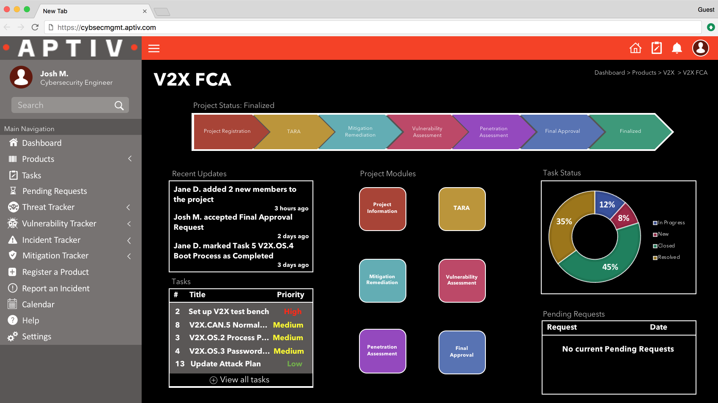
Screen Mockups: Web Interface
Example of Good Screen Mockup
Delete this slide.

Slide 13


Screen Mockup: iOS Application
Example of Good Screen Mockups
Delete this slide.

Slide 14
Project Technical Specifications
Point 1
Point 2
Point 3
Etc…
List the technical components of your project.
Delete this textbox.

Slide 15
Project System Architecture
Show a diagram that illustrates the overall architecture of your project including how all of the parts and pieces are connected and interact.
See below for examples and instructions.
Delete this textbox.

Slide 16
System Architecture Slide Notes
Notes on Making Your Diagram
Delete this slide.
Draw your system architecture diagram natively in PowerPoint; do not cut-and-paste a diagram from your Project Plan document.
Create your system architecture diagram in a separate PowerPoint file.
  Use a white background with a blank slide layout.
  Use Home > Arrange > Group to group all of the objects in your diagram into one single PowerPoint object that can be copied-and-pasted.
  Once grouped, save the diagram as a PNG image so that the entire image will scale including text.
Use Paint.NET to make the background of your diagram transparent.
  Download and install it from www.getpaint.net.
  Copy your diagram into Paint.NET.
  Select Tool > Magic Wand.
  Click on a background area.
  Push the Delete button (on your keyboard).
  The background area should be a checkerboard pattern.
  (N.B.: Paint.NET was a capstone project at the University of Washington.)
Copy-and-paste your PNG image into the slide deck System Architecture slide.
Ensure that your diagram…
  is readable (size-wise) when projected,
  has the correct aspect ratio,
  is scalable, and
  is centered vertically (between the green bar in the title and the footer) and horizontally (Use Home > Arrange > Align).
Read this carefully.

Slide 17
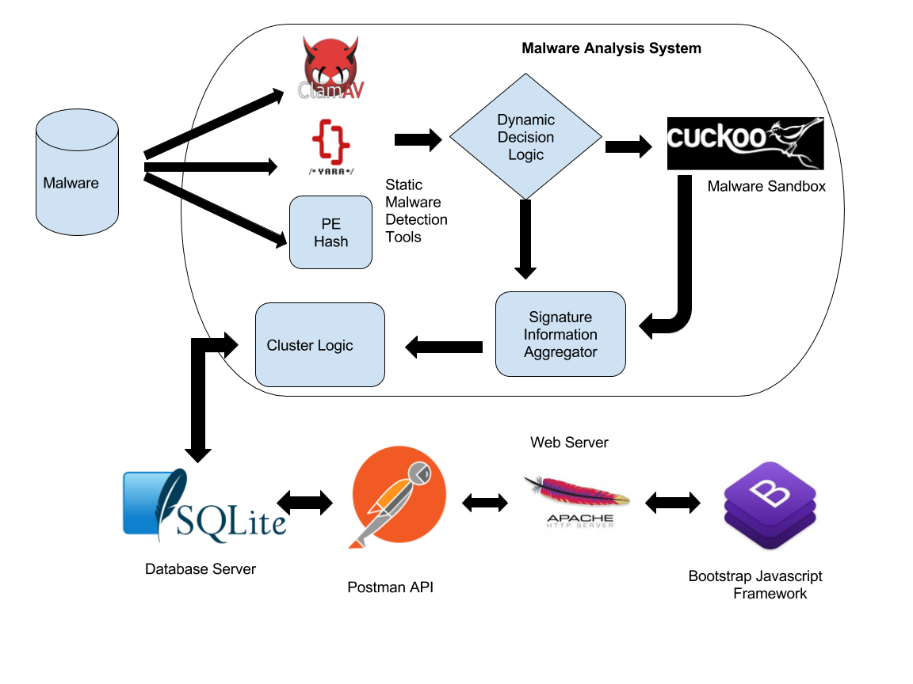
System Architecture Slide Notes
Example of Good System Architecture Diagram
Delete this slide.

Slide 18
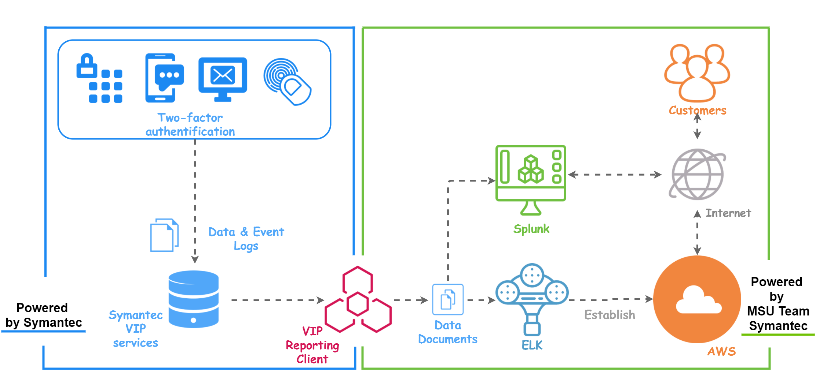
System Architecture Slide Notes
Example of Good System Architecture Diagram
Delete this slide.

Slide 19
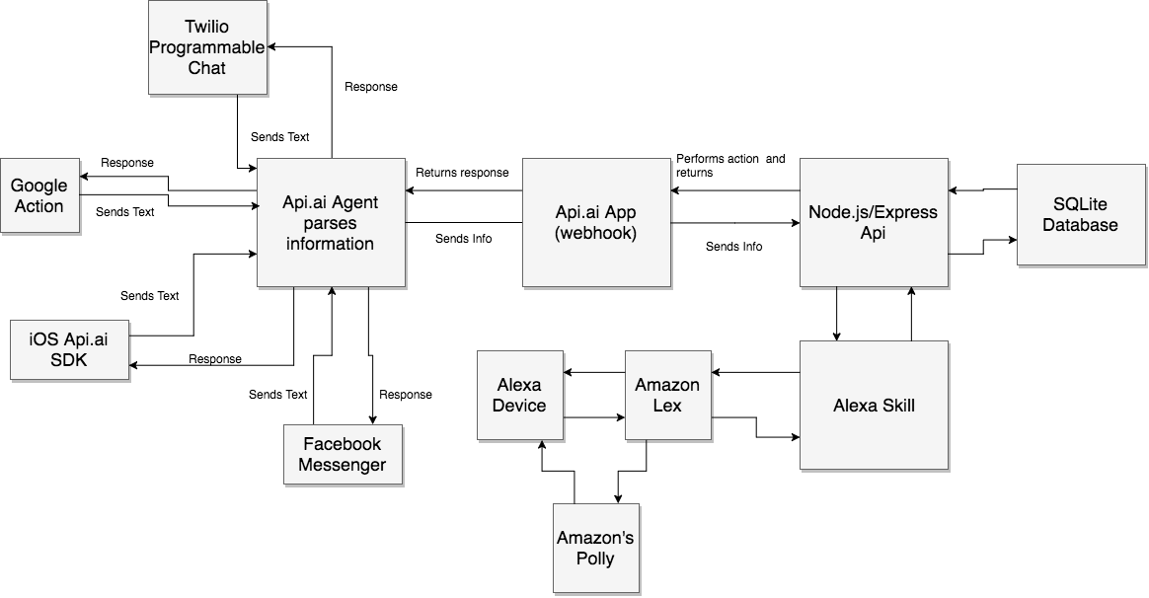
System Architecture Slide Notes
Example of BAD System Architecture Diagram
Delete this slide.
Black and white blurry copy-and-paste from Project Plan document.

Slide 20
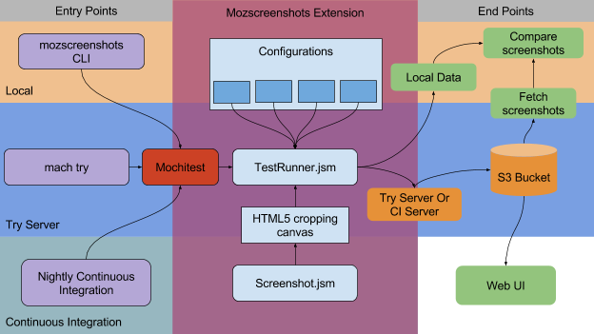
System Architecture Slide Notes
Example of BAD System Architecture Diagram
Delete this slide.
Blurry copy-and-paste from Project Plan document.

Slide 21
Project System Components
Hardware Platforms
  Point 1
  Point 2
  Point 3
  Etc…
Software Platforms / Technologies
  Point 1
  Point 2
  Point 3
  Etc…
List your hardware and software platforms including all of the technologies that your project will use.
Delete this textbox.

Slide 22
Project Risks
Do NOT modify the title of this slide in any way.
List your project risks on this one slide in bullet points.
Delete this textbox.
Risk 1
  Description
  Mitigation
Risk 2
  Description
  Mitigation
Risk 3
  Description
  Mitigation
Risk 4
  Description
  Mitigation
Articulate your major risks.
For each risk, describe what the risk is and how you plan on mitigating it.
DO NOT duplicate this slide. All of your risks must fit on this one slide.
Delete this textbox.

Slide 23
Questions?
?
?
?
?
?
?
?
?
?

